Slide 1
Theories of Child Personality Development:
Erikson’s Theory of Psychosocial Development
Third Stage
Dr. Moustafa Alshammari
Growth and Developments

Slide 2

Learning Objectives
Mastery of content in this lecture will enable the student to:
1
Identify the major concepts of selected theories of development.
Compare the major points of view related to the formulation of selected developmental theories.
Assess the relevance of selected theories of development to nursing care of children, adults, and old age.
2
3

Slide 3

Erikson's Concept of Development
Erik Erikson's stages’ theory of psychosocial development contributed to our understanding of personality development throughout the lifespan.

Slide 4
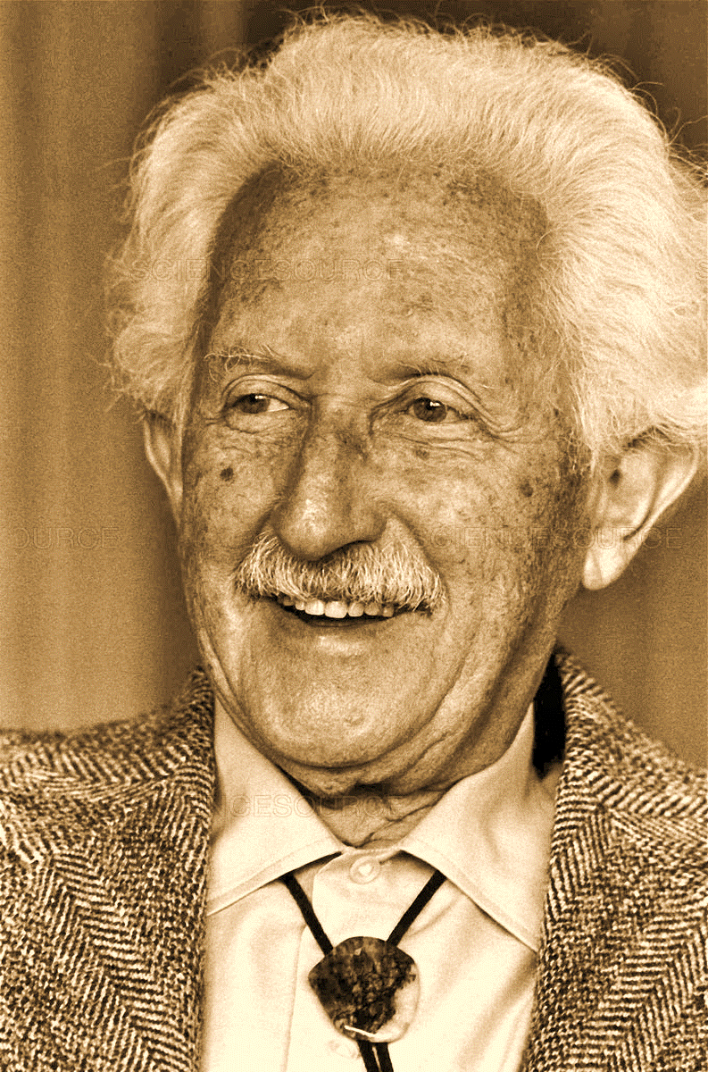
Erik Erikson
Erik Erikson was born June 15, 1902.
Died May 12, 1994.

Slide 5
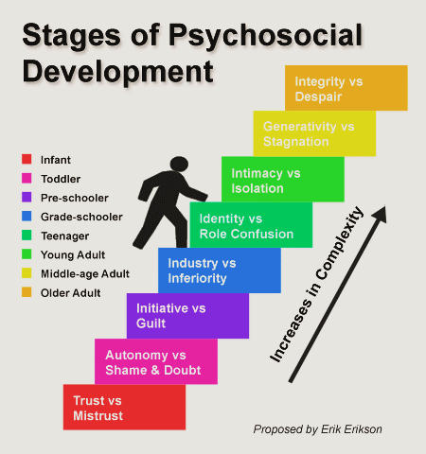
Erikson's Concept of Development
Erickson defines eight developmental phases.
Five of these phases attribute to childhood and three attribute to adulthood.
Uses the word sense to describe the affective states being dealt with in the progression (sequences) of development in each phase.

Slide 6
Development for Erickson is Tridimensional:
There is the progression from one phase to another.
Development involves a set of mutual (shared) feelings:
      Between infant and one-child-caring person (mother).
      Between child and child caring persons later.
      Between child and peers.
      Then between adolescent and his peers.
      In early adulthood, mutuality is between intimate friends and parents.
      Later between generations.
Development is relative.

Slide 7

Stage : A sense of basic trust V.S mistrust (birth – 1 year)
1
Affective development, that is, emotional development, is started in the very early experience of this phase.
Infants are born with their basic abilities needed for extra-uterine survival, such as respiration, thermoregulation and digestion.
They cannot survive without the care given to provide for those essential needs such as food, warmth and, security.

Slide 8
Stage : A sense of basic trust V.S mistrust (birth – 1 year)
1
For the newborn, a sense of trust requires a feeling of physical comfort and a minimum amount of uncertainty (insecurity) and discomfort.
In contrast, a sense of mistrust arises with unsatisfactory physical experiences and the association of frustration with them.
Frustration > feeling of fear and lack of hope for finding the desired change.
Trust > helps the infant to feel confident in himself as well as in others.

Slide 9
Stage : A sense of basic trust V.S mistrust (birth – 1 year)
1
During the first 3 to 4 months:
Much of the infant's routine centers around the intake of food, light, sound and around general bodily tactile stimulations.
Oral contact and sucking alleviate (relieve) discomfort while providing them with a source of satisfaction.
Love and pleasure of dependency,
Important in this phase, are given or provided to the child through his mother or the care giver by her comforting warmth, smile, and way of talking, as well as through the quality of care.

Slide 10
Stage : A sense of basic trust V.S mistrust (birth – 1 year)
1
The infant develops a sense of trust when he learns that his outside world is a giving one and when his needs are satisfied properly.
A sense of mistrust develops when there is too much or too little frustration resulting from too late gratification (satisfaction) of needs.

Slide 11

Stage : A sense of autonomy V.S doubt and shame (1- 3 yrs.)
2
When the infant gains trust in his outside world and way of life, he is ready to acquire a sense of autonomy and he realizes his will.
He starts to practice being independent; however, his continued dependencies create a sense of doubt in his abilities and capacities, and also create a sense of shame for continuing to be dependent on his mother.

Slide 12
Stage : : A sense of autonomy V.S doubt and shame (1- 3 yrs.)
2
Specific developmental tasks a toddler will deal with:
Differentiation of himself from others, particularly his mother.
Toleration of separation from mother, parents, and family.
Ability to interact with others in less egocentric (selfish), autistic manner.

Slide 13


Stage : : A sense of autonomy V.S doubt and shame (1- 3 yrs.)
2
Characteristics of typical autonomy:
Negativism
the toddler starts to use the word "No"
Ritualism
doing certain actions or behaving in a ritual manner i.e. repeat certain behavior several times.

Slide 14

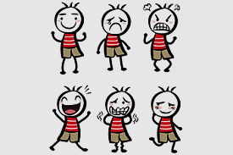
Stage : A sense of autonomy V.S doubt and shame (1- 3 yrs.)
2
Characteristics of typical autonomy:
Emotions becomes very strongly expressed
e.g. one minute the child can be involved in an activity and the next minute he might be violently angry because he was unable to manipulate a toy or to open a box or a door.
Temperament
(is the manner of thinking, behaving or reacting characteristic of an individual and refers to the way in which a person deals with life) may appear if he is scolded for doing something wrong.

Slide 15
Stage : A sense of initiative and V.S guilt (3/4 – 5 yrs.)
3
The child in this phase starts to be more active and positive in performing certain tasks.
Erickson refers to these developmental years as the "Play age".
The use of the language in this phase is improved.

Slide 16
Stage : A sense of initiative and V.S guilt (3/4 – 5 yrs.)
3
Psychological development in this phase centers in to major tasks:
The child begins his relationship with others such as parents, peers, and other adult in the life.
The child begins to notice sex differences – the children are now experiencing being a boy or girl.

Slide 17
Stage : A sense of industry V.S inferiority (6 – 11 years.)
4
The divergence of this phase is a sense of industry versus a sense of inferiority.
The child's energy is directed toward inventions and production.
Beginning to create, develop, and manipulate.
Developing sense of competence and perseverance.

Slide 18
Stage : A sense of Identity V.S Identity diffusion (12-20 years.)
5
A sense of identity means a sense of being at one with oneself as one grows and develops.
Identity development is closely linked with the mastery of skills.
Achieving a sense of identity as well as overcoming a sense of identity diffusion
Children physically mature into adulthood; they experience rapid body growth, important physiological and anatomical changes.
Previous trust in their body and their mastery of its functions is suddenly shaken.

Slide 19
Stage : A sense of Identity V.S Identity diffusion (12-20 years.)
5
Young adolescents experience a close attachment to their parents while they reach for new and more satisfactory contacts in association outside the family.
They learn to interact with more and more people at a given times and they learn in which way they should relate to them. In this process they become individuals in and members of their community.

Slide 20
Stage : A sense of Identity V.S Identity diffusion (12-20 years.)
5
Adolescents develop their relationship with significant adult in his/her life.
Identity development moves from the reality of being to the reality of becoming

Slide 21
Stage : A sense of intimacy and solidarity V.S Isolation (20-40 years.)
6
This period is a time to enjoy life with adult liberty and responsibility.
The major developmental theme now involves psychological readiness and a commitment to mutual intimacy in the partnership of marriage.
In this phase a foundation is prepared for the couple's own life and the lives of others. Graduation from adolescence requires a sense of shared identity.
Intimacy involves a balance between giving to other and maintaining oneself.

Slide 22
Stage : A sense of Generativity V.S self absorption (40 - 60 years.)
7
The second of developmental phase of adulthood deals with assuring care for the new generation.
Generativity refers to the care they provide as a unit in society at large to the next generation.
It is the period in life when individuals are productive in work to satisfy themselves and people beyond their own family borders.

Slide 23
Stage : A sense of Integrity V.S Despair (60 years & above.)
8
Integrity refers to the acceptance of the individual life cycles of human beings as something that has to be. If in old age one prefers not to be what one was not meant to be, one has found a sense of integrity.
It includes overcoming a sense of despair, a sense of disgust at certain life styles, and a fear of death at the end.

Slide 24
Stage : A sense of Integrity V.S Despair (60 years & above.)
8
In this phase, one often finds wisdom and a philosophy of life which extends beyond one's own life cycle to future developmental cycle.
With a faith and trust in generations, Erickson says:
" healthy children will not fear life, if their parents have integrity enough not to fear death"

Slide 25
Stage | Basic Conflict | Important Events | Outcome
Infancy (birth to 18 months) | Trust vs. Mistrust | Feeding | Children develop a sense of trust when caregivers provide reliability, care, and affection. A lack of this will lead to mistrust.
Early Childhood (2 to 3 years) | Autonomy vs. Shame and Doubt | Toilet Training | Children need to develop a sense of personal control over physical skills and a sense of independence. Success leads to feelings of autonomy, failure results in feelings of shame and doubt.
Preschool (3 to 5 years) | Initiative vs. Guilt | Exploration | Children need to begin asserting control and power over the environment. Success in this stage leads to a sense of purpose. Children who try to exert too much power experience disapproval, resulting in a sense of guilt.
School Age (6 to 11 years) | Industry vs. Inferiority | School | Children need to cope with new social and academic demands. Success leads to a sense of competence, while failure results in feelings of inferiority.
Adolescence (12 to 18 years) | Identity vs. Role confusion | Social Relationships | Teens needs to develop a sense of self and personal identity. Success leads to an ability to stay true to yourself, while failure leads to role confusion and a weak sense of self.
Young Adulthood (19 to 40 years) | Intimacy vs. Isolation | Relationships | Young adults need to form intimate, loving relationships with other people. Success leads to strong relationships, while failure results in loneliness and isolation.
Middle Adulthood (40 to 65 years) | Generativity vs. Stagnation | Work and Parent Hood | Adults need to create or nurture things that will outlast them, often by having children or creating a positive change that benefits other people. Success leads to feelings of usefulness and accomplishment, while failure results in shallow involvement in the world.
Maturity (65 to death) | Ego Integrity vs. Despair | Reflection on Life | Older adults need to look back on life and feel a sense of fulfillment. Success at this stage leads to feelings of wisdom, while failure results in regret, bitterness, and despair.
E. Erickson’s stages of development

Slide 26
Thank you

